Slide 1
S Block Elements
Mr. D. V. Bondar
Dept. Of Chemistry
S.C.S.College, Omerga.

Slide 2
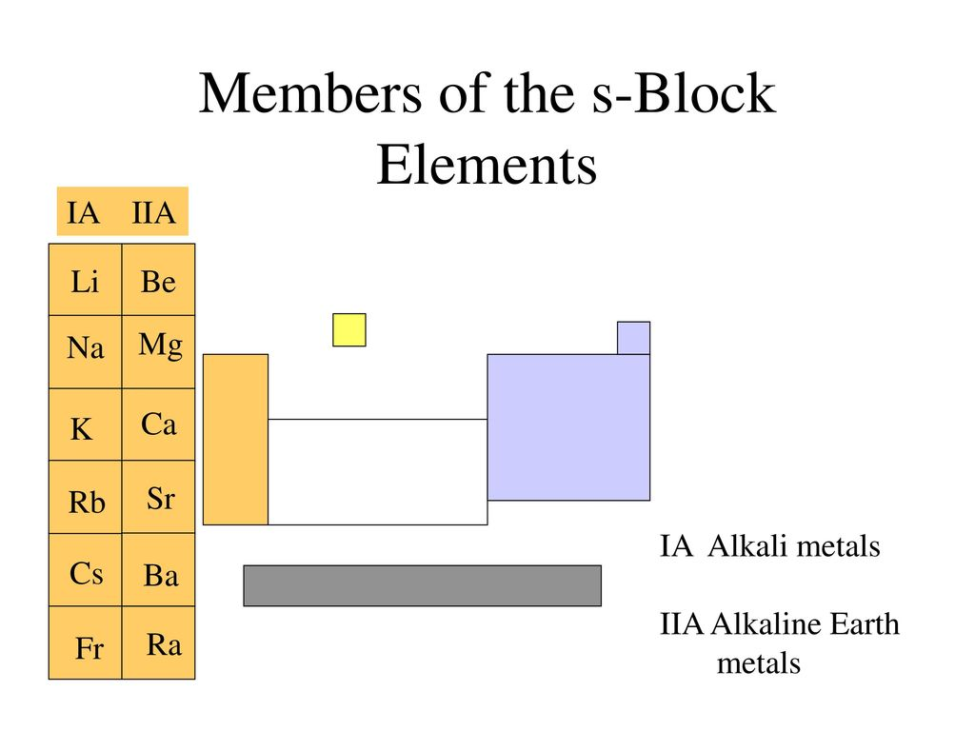

Slide 9
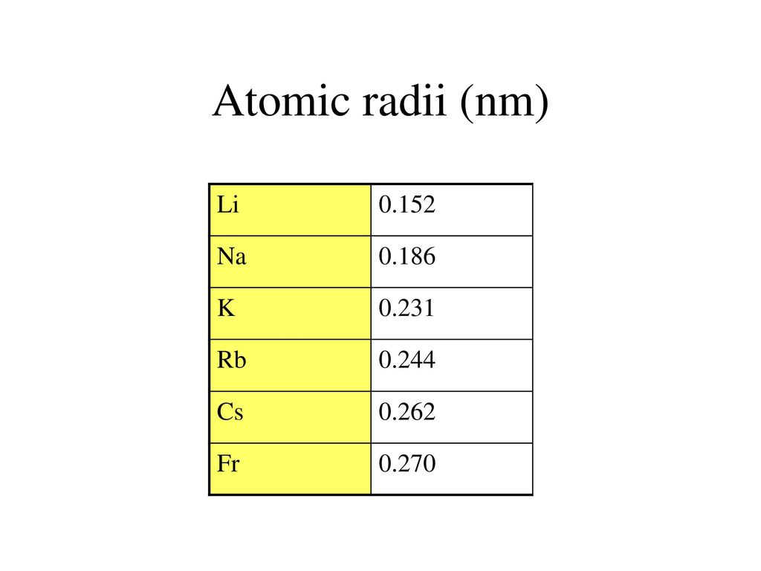

Slide 27
CHEMICAL PROPERTIES:

Slide 36
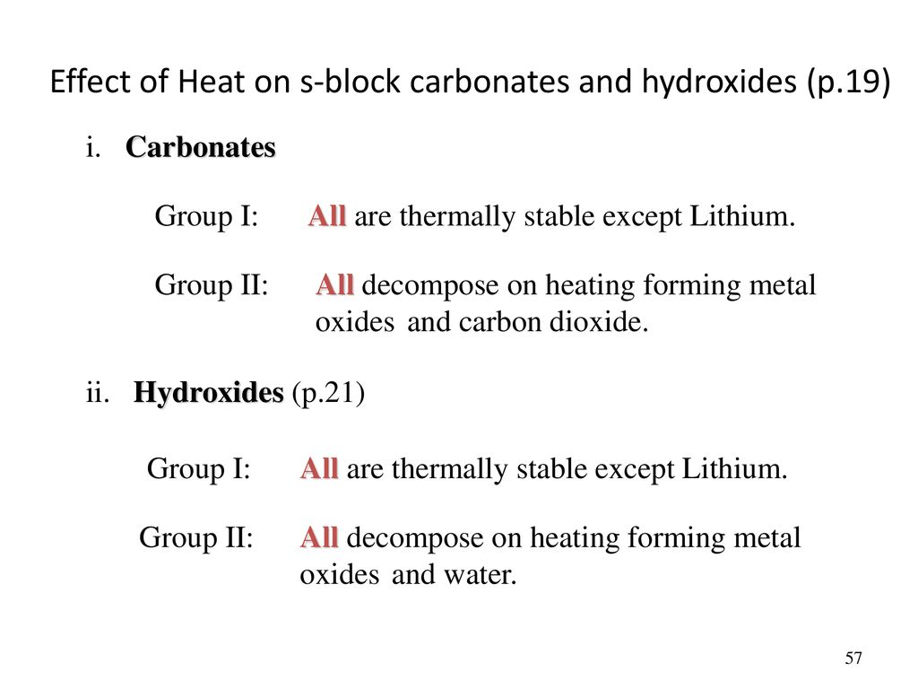

Slide 37
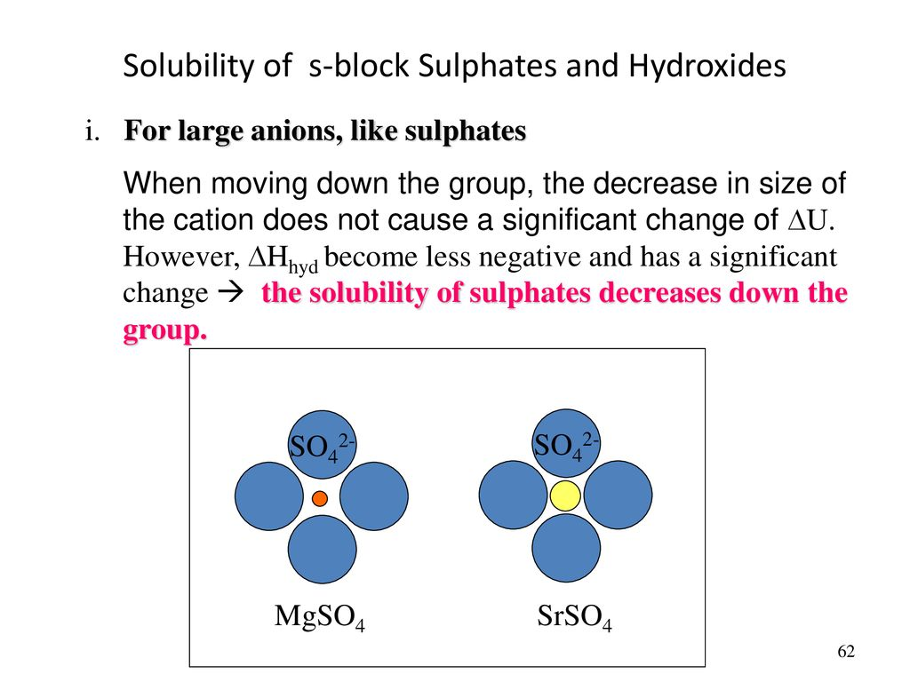

Slide 40
ANOMALOUS PROPERTIES OF LITHIUM:
The anomalous behaviour of lithium is due to the :
(i) exceptionally small size of its atom and ion, and
(ii) high polarising power (i.e., charge/radius ratio). As a result, there is increased covalent character of lithium compounds which is responsible for their solubility in organic solvents. Further, lithium shows diagonal relationship to magnesium which has been discussed subsequently.

Slide 41
Points of Difference between Lithium and other Alkali Metals
(i) Lithium is much harder. Its m.p. and b.p. are higher than the other alkali metals.
(ii) Lithium is least reactive but the strongest reducing agent among all the alkali metals. On combustion in air it forms mainly monoxide, Li2O and the nitride, Li3N unlike other alkali metals.
(iii) LiCl is deliquescent and crystallises as a hydrate, LiCl.2H2O whereas other alkali metal chlorides do not form hydrates.
(iv) Lithium hydrogencarbonate is not obtained in the solid form while all other elements form solid hydrogencarbonates.
(v) Lithium unlike other alkali metals forms no ethynide on reaction with ethyne.
(vi) Lithium nitrate when heated gives lithium oxide, Li2O, whereas other alkali metal nitrates decompose to give the corresponding nitrite. 4LiNO 2 Li O 4 NO O 3 2 22 →++ 2 NaNO 2 NaNO O 3 22 → +
(vii) LiF and Li2O are comparatively much less soluble in water than the corresponding compounds of other alkai metals.

Slide 42
Diagonal relationship:. A diagonal relationship is said to exist between certain pairs of diagonally adjacent elements in the second and third periods (first 20 elements) of the periodic table. These pairs (lithium (Li) and magnesium (Mg), beryllium (Be) and alluminium (Al), boron (B) and silicon (Si), etc.) exhibit similar properties

Slide 43
Diagonal relationship of Li and Mg:
The similarity between lithium and magnesium is particularly striking and arises because of their similar sizes : atomic radii, Li = 152 pm, Mg = 160 pm; ionic radii : Li+ = 76 pm, Mg2+= 72 pm. The main points of similarity are:
(i) Both lithium and magnesium are harder and lighter than other elements in the respective groups.
(ii) Lithium and magnesium react slowly with water. Both Li and Mg form covalent organometallic compounds. LiMe and MgMe₂ (cf. Grignard reagents) are both valuable synthetic reagents
(iii)Their oxides and hydroxides are much less soluble and their hydroxides decompose on heating.
(iv) Both form a nitride, Li3N and Mg3N2, by direct combination with nitrogen.
(v) The oxides, Li2O and MgO do not combine with excess oxygen to give any superoxide.
( vi) The carbonates of lithium and magnesium decompose easily on heating to form the oxides and CO2. Solid hydrogencarbonates are not formed by lithium and magnesium.
(v) Both LiCl and MgCl2 are soluble in ethanol.
(vi) Both LiCl and MgCl2 are deliquescent and crystallize from aqueous solution as hydrates, LiCl·2H2O and MgCl2·8H2O

Slide 44
ANOMALOUS BEHAVIOUR OF BERYLLIUM:
ANOMALOUS BEHAVIOUR OF BERYLLIUM Beryllium: the first member of the Group 2 metals, shows anomalous behaviour as compared to magnesium and rest of the members. Further, it shows diagonal relationship to aluminium which is discussed subsequently.
(i) Beryllium has exceptionally small atomic and ionic sizes and thus does not compare well with other members of the group. Because of high ionisation enthalpy and small size it forms compounds which are largely covalent and get easily hydrolysed.
(ii) Beryllium does not exhibit coordination number more than four as in its valence shell there are only four orbitals. The remaining members of the group can have a coordination number of six by making use of d-orbitals.
(iii) The oxide and hydroxide of beryllium, unlike the hydroxides of other elements in the group, are amphoteric in nature.

Slide 51
Diagonal Relationship between Beryllium and Alluminium:
The ionic radius of Be2+ is estimated to be 31 pm; the charge/radius ratio is nearly the same as that of the Al3+ ion. Hence beryllium resembles aluminum in some ways.
Some of the similarities are: (i) Like aluminum, beryllium is not readily attacked by acids because of the presence of an oxide film on the surface of the metal.
(ii) Beryllium hydroxide dissolves in excess of alkali to give a beryllate ion, [Be(OH)4] 2– just as aluminum hydroxide gives aluminate ion, [Al(OH)4] – .
(iii) The chlorides of both beryllium and aluminum have Cl– bridged chloride structure in vapor phase. Both the chlorides are soluble in organic solvents and are strong Lewis acids. They are used as Friedel Craft catalysts.
(iv) Beryllium and aluminum ions have strong tendency to form complexes, BeF4 2–, AlF6 3–.

Slide 52
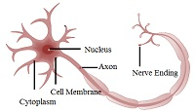
Biological importance of s-block elements
Sodium ions are found in the blood plasma and in the interstitial fluid surrounding the cells.
They stimulate the nerve signals and also regulate the flow of water across cell membranes. It also transports the sugars and amino acids into cells.
A potassium ion activates many enzymes within the cell fluids and also oxidizes glucose to produce ATP.
Enzymes utilizing ATP requires magnesium as co-factor.
The pigment responsible for absorption of light by the leaves during photosynthesis is chlorophyll which contains magnesium.
In human body calcium is present in bones and teeth.
It plays a crucial role in neuromuscular function, intraneuronal transmission, cell membrane integrity and blood coagulation.
The calcium concentration in plasma is maintained by the hormones namely, calcitonin and parathyroid.

Slide 53
The End

